Slide 1


COLLEGE MANAGEMENT SYSTEM
Operational Efficiency and Data-Driven Insights
Bipul Kumar | October 2025

Slide 2





Problem Statement & Objectives
Problem Statement
The college lacks proper data analysis, hindering management's ability to identify progress and improve operational efficiency.
Objective
To leverage existing data (Courses, Students, Faculty, Enrollments) to provide actionable insights through SQL analysis and a Power BI dashboard.

Slide 3
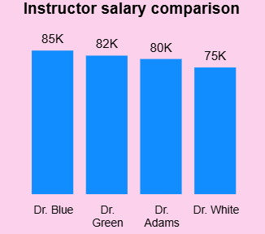
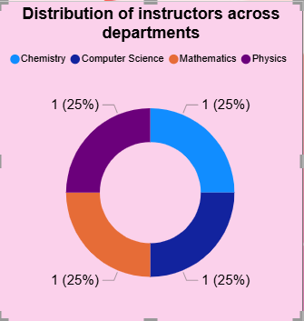
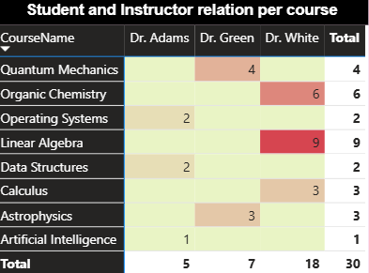
Faculty and Enrollment Insights
Salary Distribution
Key Finding
Dr. Blue is the Highest paid Instructor whereas Dr. White is the lostest Paid Instructor
Faculty are Evenly Spread in each department
Student Instructor relation
Majority of the enrollment are done for Dr White
There is no enrollment done for Chemistry department
No enrollment done for Dr. Blue

Slide 4
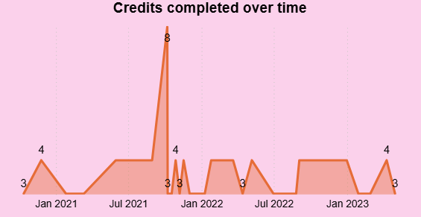
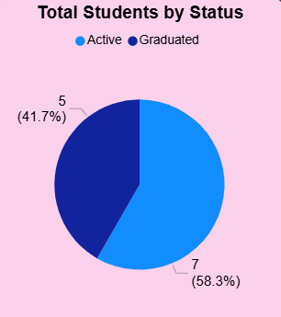
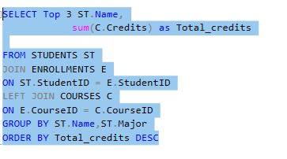

Student Performance & Status
Students By status
It can be clearly seen that majory of students are active.
Credits Completed Over Time
Majorty of the credits are completed in year 2021 and 2022.
Top 3 Students by Credits Earned.

Slide 5

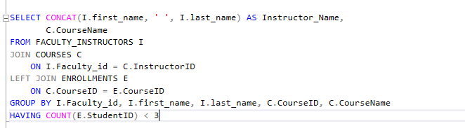
Deeper Dive: Operational Gaps
Identifying Operational Bottlenecks
low-efficiency area
Instructors teaching courses with <3 students enrolled.
Actionable statement on efficiency
Courses from Chemistry department have low enrollment and must be reviewed. The distribution of faculty across courses appears Unbalanced

Slide 6
Conclusion and Recommendations
Recap of 3 Main Findings
1. Compensation Gaps in all the 4 faculties
2. High Enrollment in Mathematics Courses (Enrollments in only ¾ department)
3. Low Utilization in Chemistry Courses.(0 enrollment, 0 credits)
Recommendation 1
Faculty Review: Investigate salary benchmarks for low-compensated departments (e.g., Mathematics) to ensure competitive rates.
Recommendation 2
Course Rationalization: Evaluate under-enrolled courses for consolidation or retirement.
Recommendation 3
Performance Tracking: Use the Credits Over Time dashboard to proactively identify students who fall behind early.

Slide 7

THANK YOU
For the Attention

